Slide 1
Bookstore Application using MEAN Stack
Anil Erturk, Scott Zhou, Shanshan Yu
Team Four CS628 Full-Stack Development II Summer 2021
School of Technology & Computing (STC)

Slide 2
Agenda
Problem Statement
Related Work
Agile Development
User Stories
MEAN Stack
Models
Views
Controllers
Routes
Demo
Future Work
Key Reference
Q&A

Slide 3
Problem Statement
Develop a website that might used to manage the catalog for a local library

Slide 4
Related Work
Express Tutorial: The Local Library website
https://developer.mozilla.org/en-US/docs/Learn/Server-side/Express_Nodejs/Tutorial_local_library_website#overview

Slide 5
Agile Development (Kanban)
Todo | In Progress | Review | Done
README doc update(Scott) | Code review with Sonarqube(Scott) | Connect front end to back end(Shanshan) | Front End(Scott)
Record presentation(Scott) | Writing models analysis in paper(Anil) | Setup Routes and controllers(Shanshan) | Database created(Anil)

Slide 6
User Stories
As a user, I can see a list of books
As a user, I can see a detail of a book
As a user, I can modify details of a book
As a user, I can delete a book

Slide 7
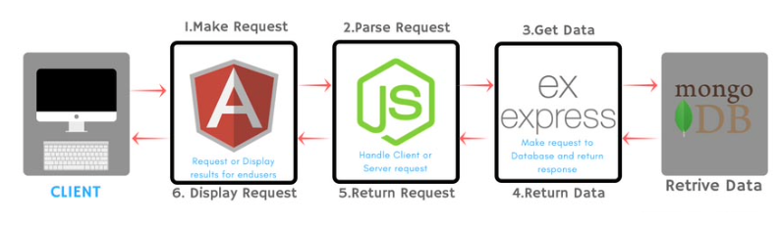
MEAN Stack
MongoDB, ExpressJS, AngularJS, NodeJS

Slide 8
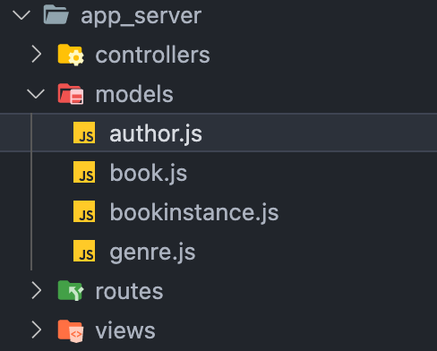
Models

Slide 9
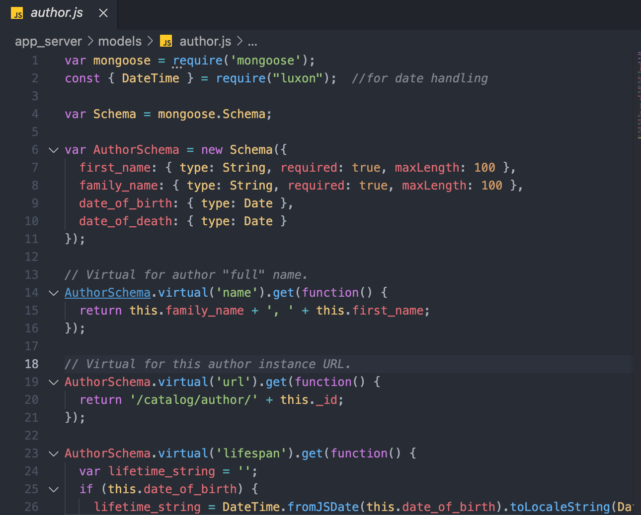
Models

Slide 10
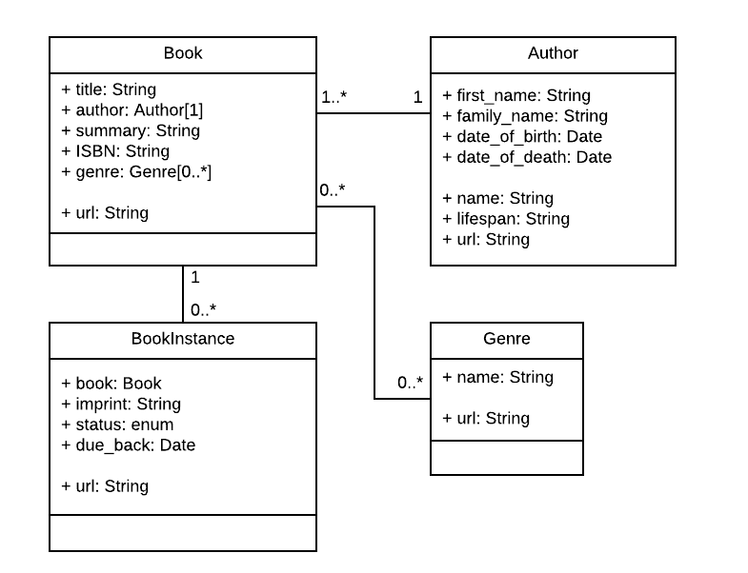
Models

Slide 11
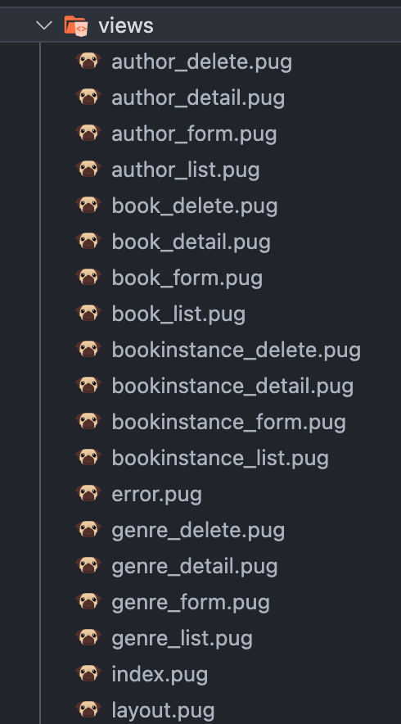
Views

Slide 12
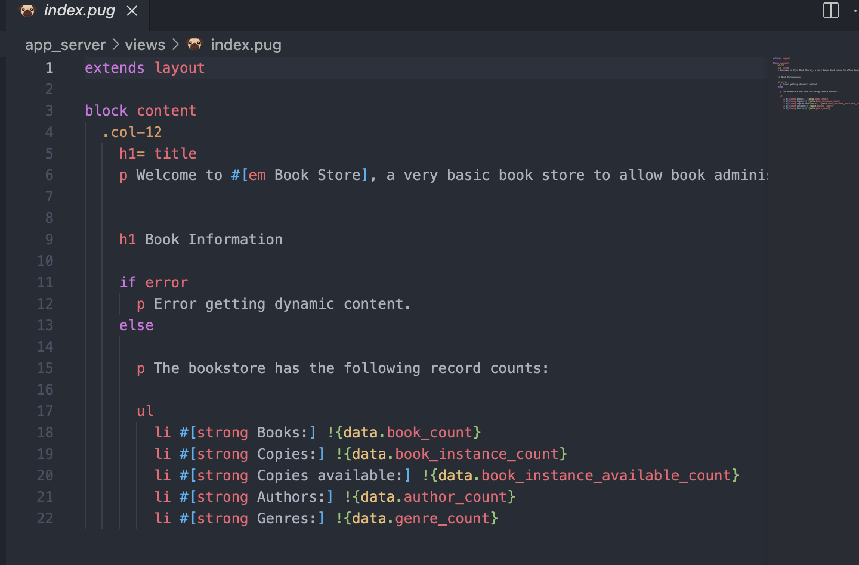
Views

Slide 13
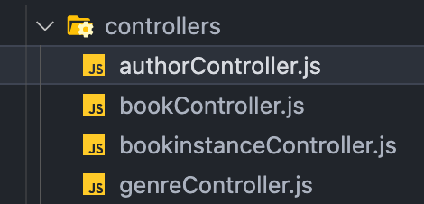
Controllers

Slide 14
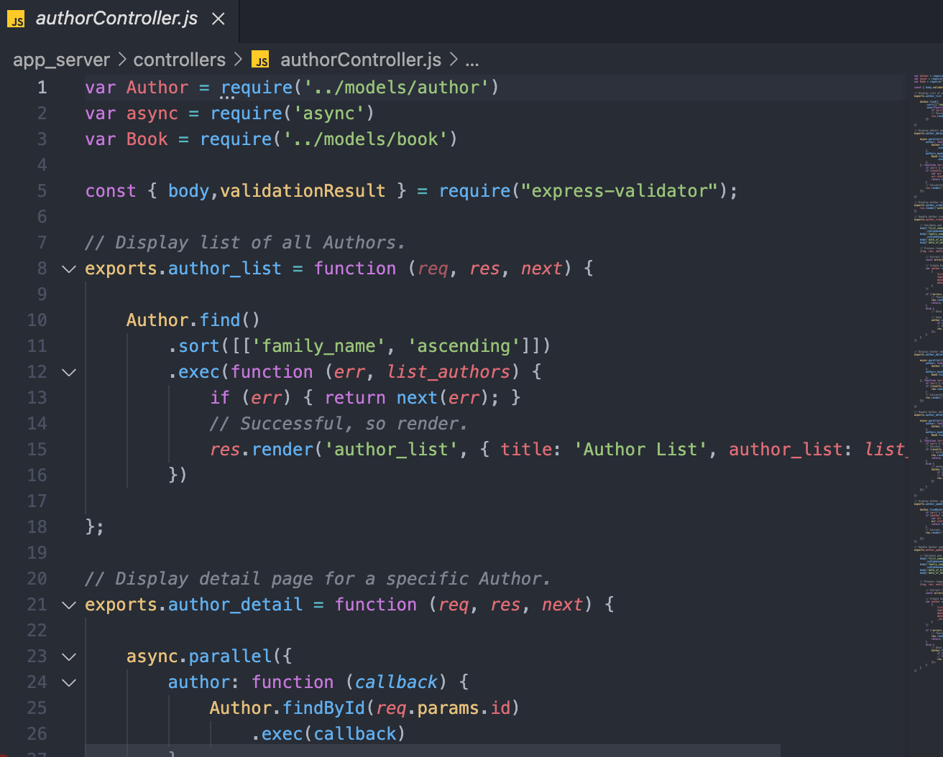
Controllers

Slide 15
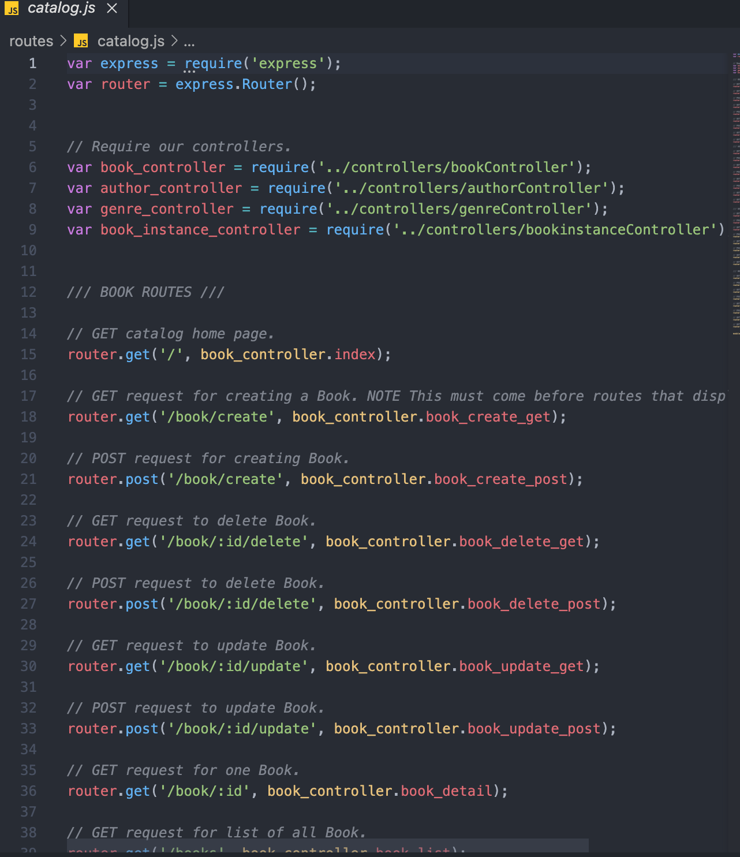
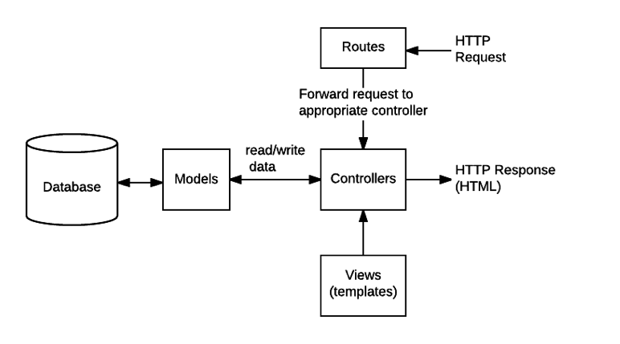

Slide 16
Demo
https://github.com/Zero0927/BookStore

Slide 17
Future Work
Improve the UI design
Run automatic code reviews
Improve documentation
Add user authentication
…

Slide 18
Reference
Anblicks. (2020, November 7). 9 Fascinating Reasons to choose MEAN stack. https://www.anblicks.com/blog/9-reasons-why-to-choose-mean-stack/
Hibbard, J. (2019, May 16). A Guide to the Pug HTML Template Preprocessor. SitePoint. https://www.sitepoint.com/a-beginners-guide-to-pug/
Invensis Learning. (2020, December 16). Scrum vs Kanban | Differences & Similarities Between Scrum & Kanban | Invensis Learning. Youtube. https://www.youtube.com/watch?v=pxxmSLJj8FQ
MDN Web Doc. (n.d.). Express Tutorial: The Local Library website. Mozilla. https://developer.mozilla.org/en-US/docs/Learn/Server-side/Express_Nodejs/Tutorial_local_library_website

Slide 19

Q&A
Thank you for your attention

